Slide 1
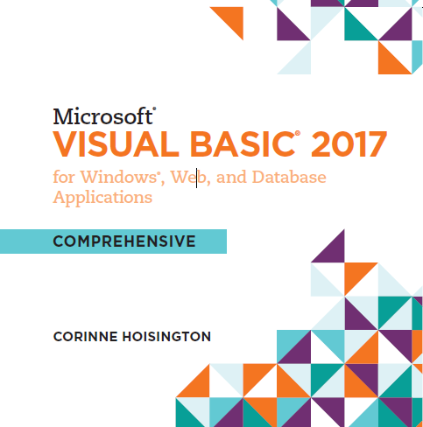

Microsoft Visual Basic 2017 for Windows®, Web, and Database Applications
Chapter 1 Introduction to Visual Basic 2017 Programming
Copyright © 2016 Cengage Learning®. May not be scanned, copied or duplicated, or posted to a publicly accessible website, in whole or in part.

Slide 2
Initial Course Objectives
Read, Understand, and Acknowledge Your Understanding of the Syllabus and the Course Requirements in the Assignments Link
The Textbook: Corinne Hoisington. (2018). Microsoft Visual Basic 2017 for Windows, Web, Windows Store, and Database Applications: Comprehensive
Textbook Learning Aids
The Tool: Visual Studio 2017 Community Edition
Communication – as you do/would professionally
Do not wait…correspond early and often.

Slide 3
Initial Course Objectives
Work ahead if possible
The assignments grow in complexity so do not wait until the weekend to begin.
If you contact me on Saturday for help, note that the remaining time before the assignment is due is limited and therefore my level of help will also be reduced.
Assignments are to be completed as stated in the textbook. i.e. If it states to create a Use Case Document along with the project, then include that in your chapter project submission.
Also, note that Assignment requirements on Canvas take precedence.

Slide 4
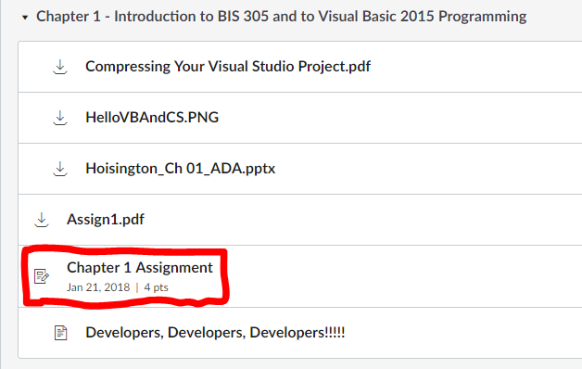
Course Information
The BIS 305 course consists of both an in-class and online segment.
The lectures will be recorded in the Thursday evening class and then made available on Canvas.
The chapter project assignments will be submitted via the assignment link for each chapter.

Slide 5
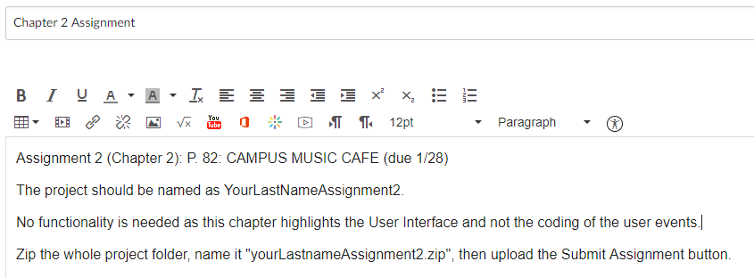
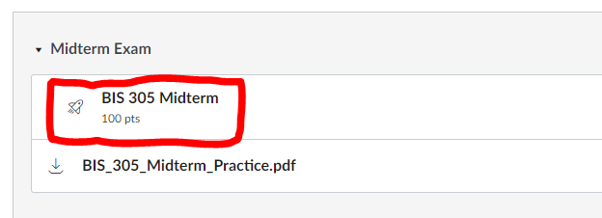
Course Information
The chapter projects links will have the page number for the textbook and any other information.
The midterm and final exams will be administered via Canvas.

Slide 6
Course Information
In this course the majority of projects are Windows Classic Desktop applications.
MAC and Linux users: Note that Visual Studio for MAC or Visual Studio Code will NOT produce standard Visual Basic.Net Windows Classic Desktop applications.¹
Therefore, MAC and Linux users must either create a Windows virtual machine on their system or utilize the NKU VPN to access a COI lab system virtual machine on which Visual Studio 2017 is installed.
The midterm and final exams will be administered via Canvas.
1. https://www.visualstudio.com/en-us/productinfo/vs2017-compatibility-mac

Slide 7
Chapter 1
Questions before we move onto Chapter 1 content?

Slide 8

Why is coding so hard?

Slide 9
Objectives (1 of 3)
Understand software and computer programs
State the role of a developer in creating computer programs
Specify the use of a graphical user interface and describe an event-driven program
Specify the roles of input, processing, output, and data when running a program on a computer
Explain the logical operations a computer program can perform

Slide 10
Objectives (2 of 3)
Define and describe the use of a database
Identify the use of a computer programming language in general and Visual Basic 2017 in particular
Explain the use of Visual Studio 2017 when developing Visual Basic 2017 programs
Specify the programming languages available for use with Visual Studio 2017
Explain the .NET Framework 4.6.2

Slide 11
Objectives (3 of 3)
Explain RAD
Describe classes, objects, and the .NET Framework class libraries
Explain ADO.NET, ASP.NET, MSIL, and CLR
Specify the types of Visual Basic 2017 applications

Slide 12
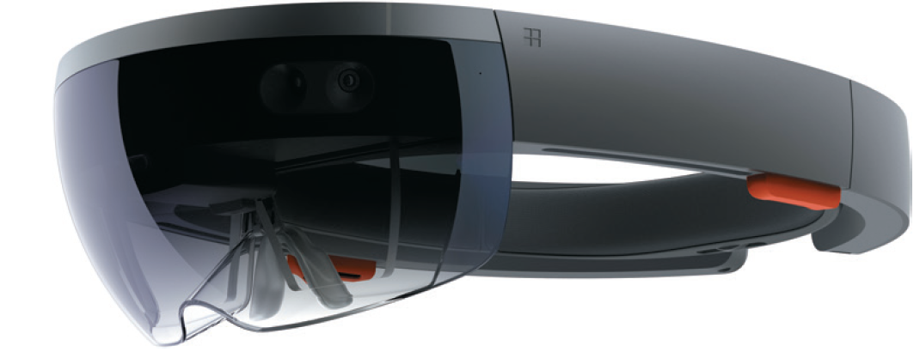
Introduction (1 of 6)
The set of instructions that directs a computer to perform tasks is called computer software, or a computer program
A computer program on a mobile device or on a Windows 10 computer is also called an app

Slide 13
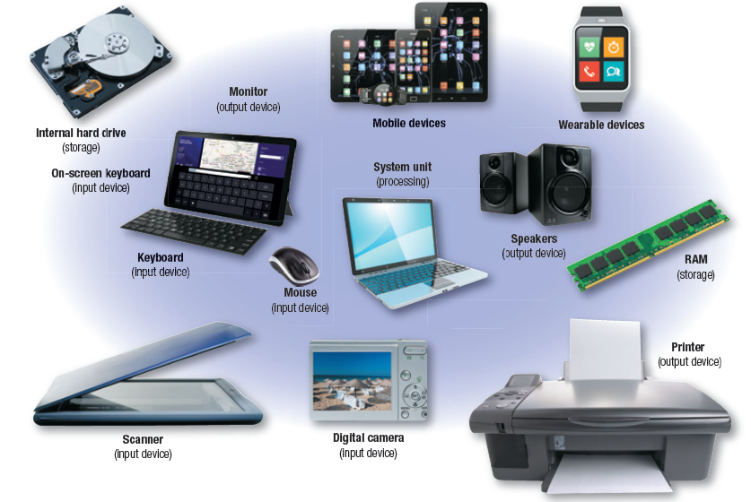
Introduction (2 of 6)
Computer hardware is the physical equipment associated with a computer
A mobile device is portable computer hardware

Slide 14
Introduction (3 of 6)
The basic function of many programs is to accept some form of data (sometimes called input data), manipulate the data in some manner (sometimes called processing), and create some form of data that is usable by people or other computers (sometimes called output data, or information)
In order for the computer to execute a program:
Program and data must be placed in the computer’s random access memory (RAM)

Slide 15

Introduction (4 of 6)
The computer’s central processing unit (CPU) can access the program instructions and the data in RAM to perform activities as directed by the program

Slide 16
Introduction (5 of 6)
Saving, or storing, data refers to placing the data or software electronically on a storage medium such as:
Hard disk
Universal Serial Bus (USB) drive
Cloud storage server
Persistent data remains available even after the computer power is turned off

Slide 17
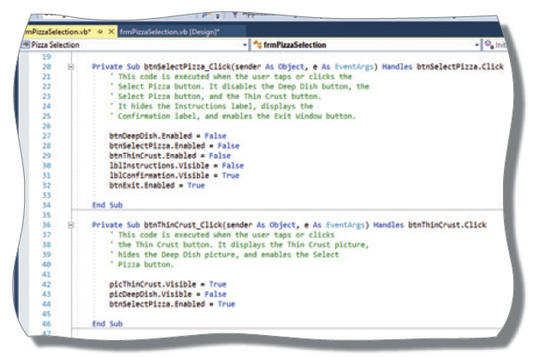
Introduction (6 of 6)

Slide 18
Developers, developers, developers!!!!

Slide 19
Computer Programmers and Developers
A computer program is designed and developed by people known as computer programmers, or developers
Developers are people skilled in designing computer programs and creating them using programming languages
Applications may consist of several computer programs working together to solve a problem
Developers create the program by writing its code using a programming language

Slide 20
Event-Driven Computer Programs with a Graphical User Interface (1 of 2)
Most Visual Basic 2017 programs are event-driven programs that communicate with the user through a graphical user interface (GUI)
The GUI usually consists of a window, containing a variety of objects
An event means the user has initiated an action that causes the program to perform a type of processing in response to that action

Slide 21
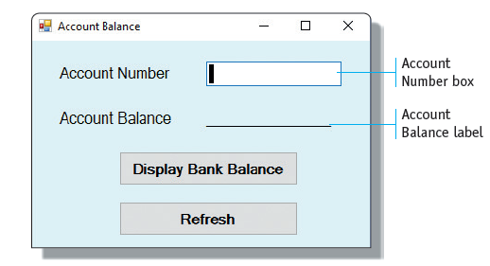
Event-Driven Computer Programs with a Graphical User Interface (2 of 2)
For example:
A user might enter data into the program and then click a button

Slide 22
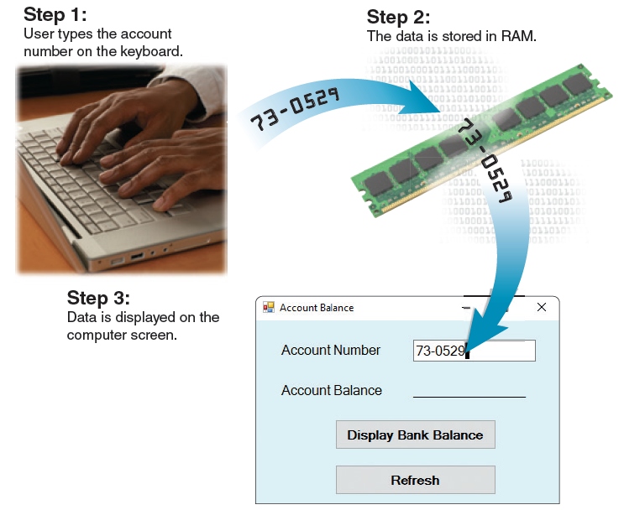
Input Operation
A fundamental operation in most computer programs involves a user who enters data

Slide 23
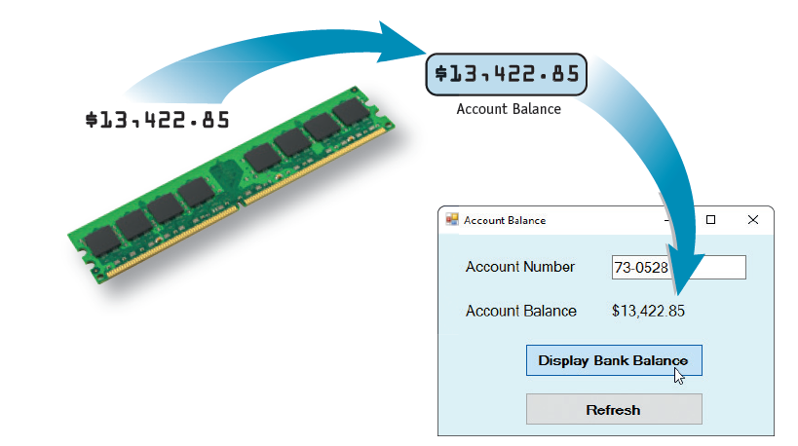
Output Operation (1 of 3)
The second basic program operation is creating output, or information

Slide 24
Output Operation (2 of 3)
As with input operations, a variety of devices can present output
In addition to computer monitors, common output devices include printers, gaming console screens, and smartphone screens

Slide 25
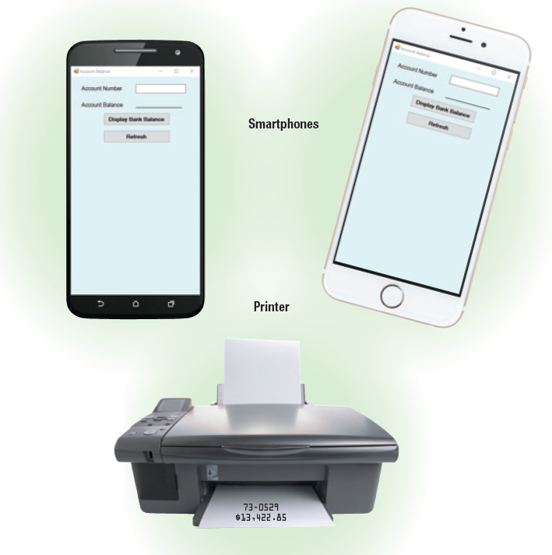
Output Operation (3 of 3)

Slide 26
Basic Arithmetic Operations
In many programs, arithmetic operations (addition, subtraction, multiplication, and division) are performed on numeric data to produce useful output

Slide 27
Logical Operations
Computers, through the use of programs, can compare numbers, letters of the alphabet, and special characters
The program can perform one processing task if the tested condition is true
A program can perform the following logical operations:
Comparing to determine if two values are equal
Comparing to determine if one value is greater than another value
Comparing to determine if one value is less than another value

Slide 28
Saving Software and Data
When you develop and write a program, the code you write and other features, such as the GUI, must be saved on disk
When you want the program to run, you can have the program loaded into RAM and executed
The program you write, however, also can save data
Banking applications must save account data
In most cases, data is stored in a database
Collection of data organized in a manner that allows access, retrieval, and use of that data

Slide 29
Visual Basic 2017 and Visual Studio 2017 (1 of 2)
Each program statement causes the computer to perform one or more operations
The developer must follow the syntax, or programming rules, of the programming language precisely
Most developers use a tool called Visual Studio 2017 to write Visual Basic 2017 programs
Visual Studio 2017 is a type of integrated development environment (IDE)
Provides services and tools that enable a developer to code, test, and implement a single program or sometimes a series of programs

Slide 30
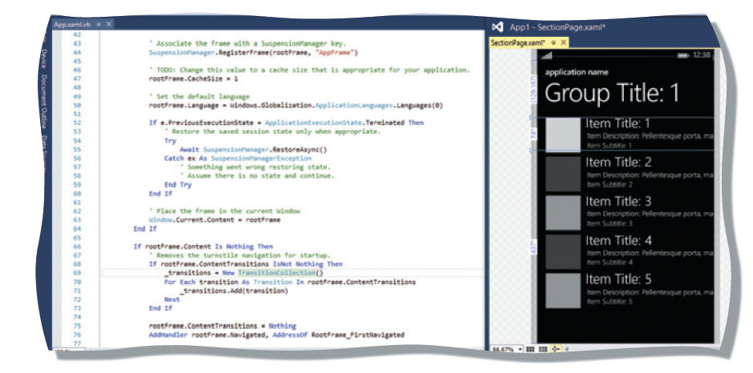
Visual Basic 2017 and Visual Studio 2017 (2 of 2)
Coded statements in the Visual Basic 2017 programming language:

Slide 31
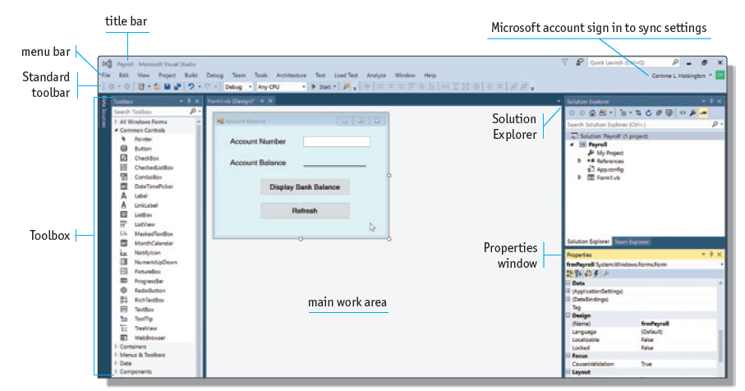
Visual Studio 2017 Window

Slide 32
Programming Languages (1 of 2)
Visual Basic
Programming language that allows developers to easily build complex Windows and web programs, as well as other software tools
Based on the BASIC language
Visual C++
Derivative of the programming language C
Visual C#
synthesis of the elegance and syntax of C++ with many of the productivity benefits enjoyed in Visual Basic

Slide 33
Programming Languages (2 of 2)
JavaScript
Open-source client-side scripting language
Visual F#
Multipurpose language known for its math-intensive focus

Slide 34
.NET Framework 4.6.2
.NET technologies and products were designed to work together to allow businesses to connect information, people, systems, and devices through software
The .NET Framework provides tools and processes that developers can use to produce and run programs
Most recent version is .NET Framework 4.7.1

Slide 35
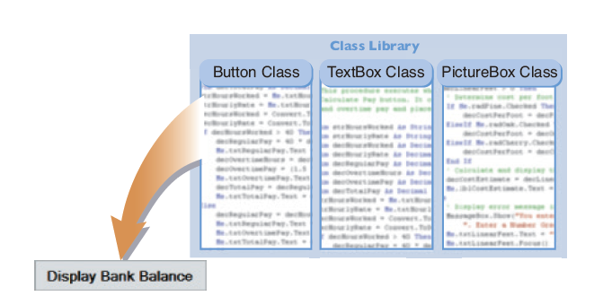
.NET Class Library (1 of 2)
A class is a named group of program code
A button is an example of a class
A class library stores the class and makes the class available to all developers who need to use it

Slide 36
.NET Class Library (2 of 2)
A button created from a class is called an object, or sometimes an instance of a class
The process of creating a Button object from the Button class is called instantiation
Rapid application development (RAD) refers to the process of using prebuilt classes to make application development faster, easier, and more reliable

Slide 37
ADO.NET
ADO.NET (ActiveX Data Objects) provides the functionality for a program to perform four primary tasks when working with a database:
Getting the data
Examining the data
Editing the data
Updating the data

Slide 38
ASP.NET
Allows developers to use Visual Studio 2017 to build powerful and sophisticated web applications
Using ASP.NET classes, programmers can create websites that perform any function available on web
ASP.NET is designed for cloud technologies and server-side applications
Cloud computing is the connection of remote servers hosted on the Internet to store and process data, instead of storing the information locally on a personal computer or device

Slide 39
Microsoft Intermediate Language and Common Language Runtime (1 of 2)
Program compilation translates programming statements into instructions that can be understood by the electronics of the computer
Program compilation for a Visual Basic 2017 program creates a set of electronic code expressed in an intermediate language called the Microsoft Intermediate Language (MSIL)
When the program is executed, a portion of .NET called the Common Language Runtime (CLR) reads the MSIL and causes the instructions within the program to be executed

Slide 40
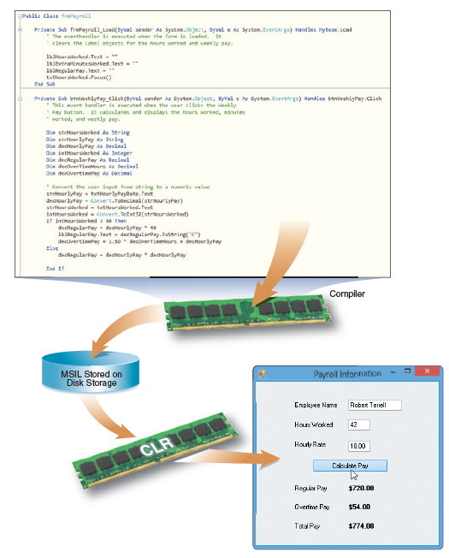
Microsoft Intermediate Language and Common Language Runtime (2 of 2)

Slide 41
Types of Visual Basic 2017 Applications
Windows Classic Desktop application
Program will run on a computer or other device that supports the Windows GUI
Windows Universal apps
Designed to run on Windows 8 or Windows 10 computers and mobile devices
Web application
Uses ASP.NET and runs on a web server
Database application
Written using ADO.NET to reference, access, display, and update data stored in a database

Slide 42
Microsoft HoloLens Development
HoloLens is the augmented reality headset that places 3-D holographic images in your scope of vision
HoloLens apps are being developed using Visual Studio:
To select car options at Volvo dealerships
To create a custom kitchen at Lowe’s Home Centers
To explore other planets at NASA
To replace a flat-screen TV with a much larger holographic display

Slide 43
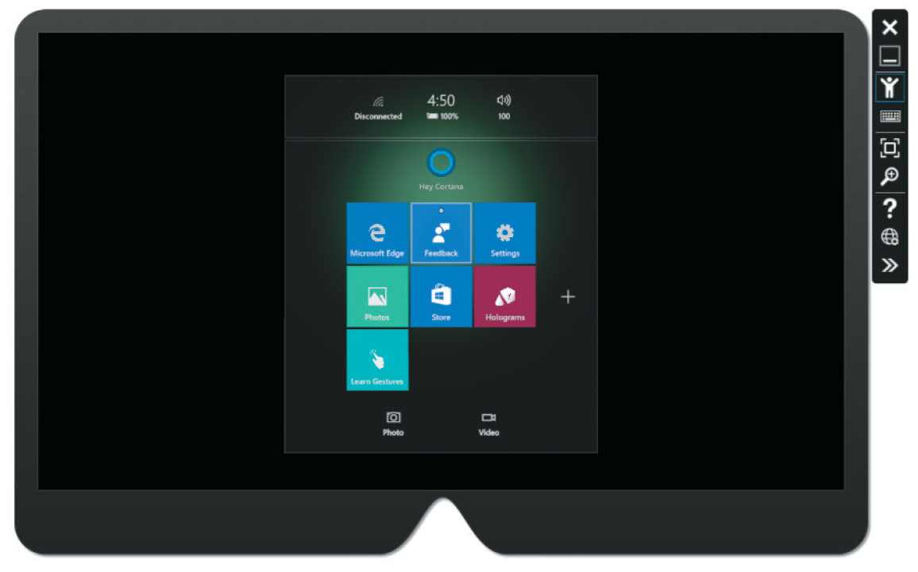
Microsoft HoloLens Development

Slide 44
Summary
Understand the fundamentals of computer programming and have been introduced to the Visual Studio 2017 and Visual Basic 2017 program development environments
In subsequent chapters, you will learn to use Visual Studio 2017 and Visual Basic 2017 to create Windows Classic Desktop applications for Windows Universal apps, database applications, Web/Cloud applications for computer and mobile devices.

Slide 45
Console App from Scratch Demo

Slide 46
Console App from Scratch…Whhhaaat?
Note that the typing of the code was unassisted.
Visual Studio will help you with autocomplete or what is also called Intellisense
Note that code compilation was manually done
Visual Studio will compile all your project’s code and referenced libraries for you
Note that I had to manually test the program
Visual Studio will assist you in the test and debugging of you program.

Slide 47

Console App with Visual Studio

Slide 48
Questions
?

